Slide 1

Right and Wrong in a Warming World

Slide 2
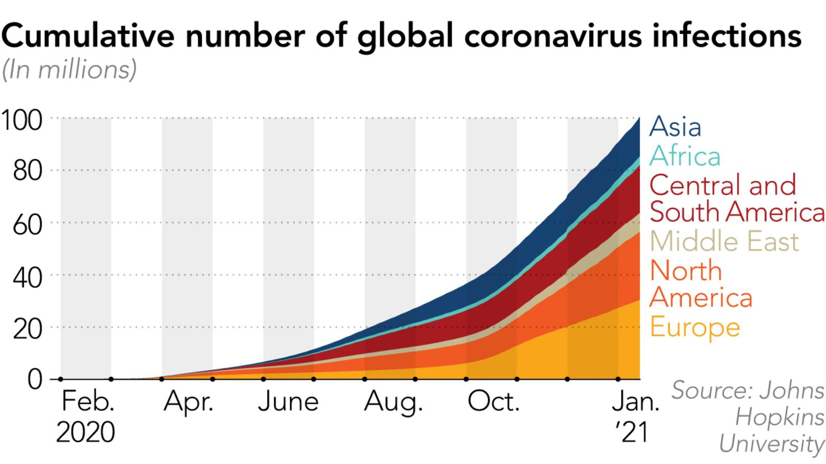
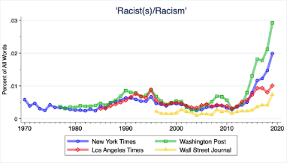
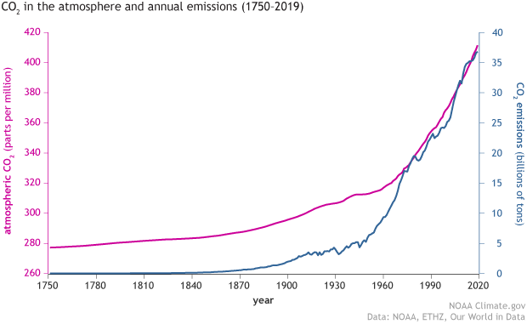
Right and Wrong in a Warming World
https://www.tabletmag.com/sections/news/articles/media-great-racial-awakening
https://www.climate.gov/news-features/understanding-climate/climate-change-atmospheric-carbon-dioxide

Slide 3
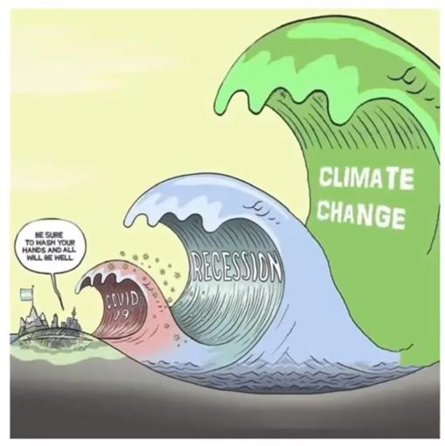
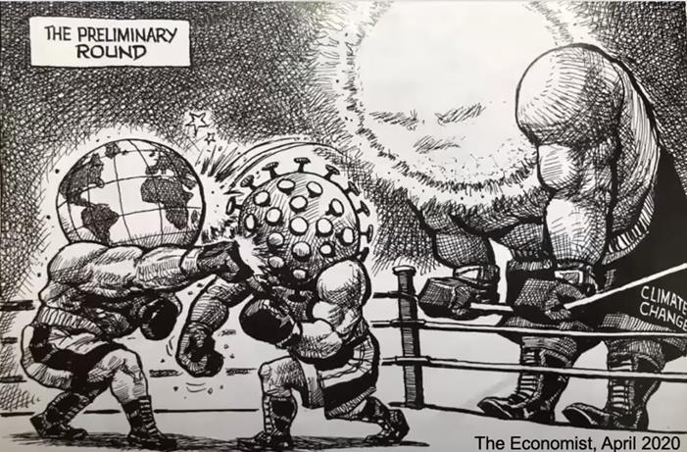

Slide 4

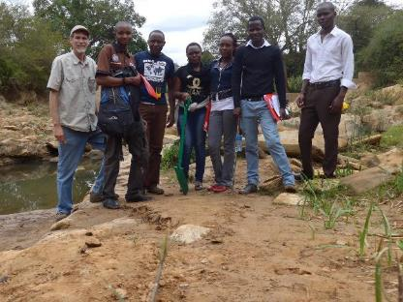

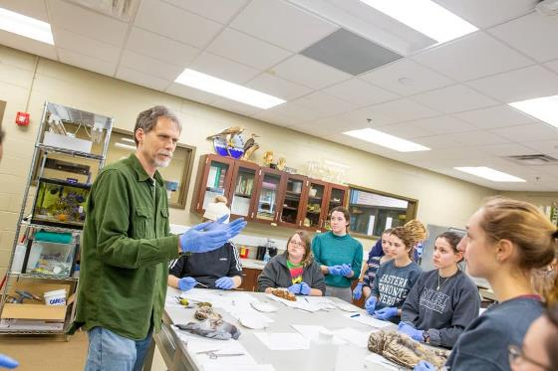
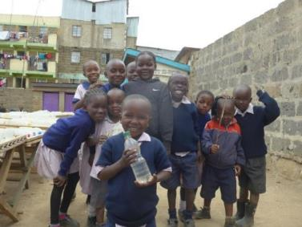
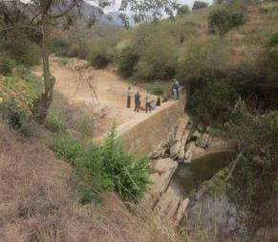

Slide 5
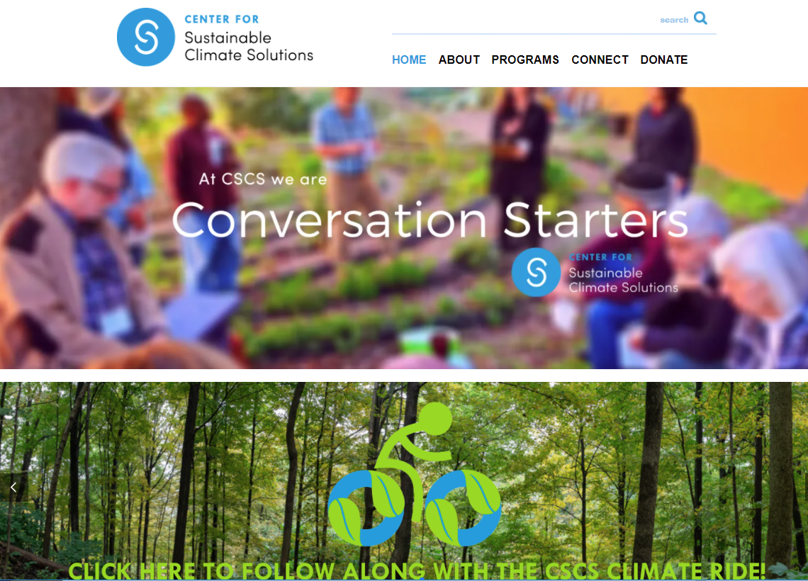
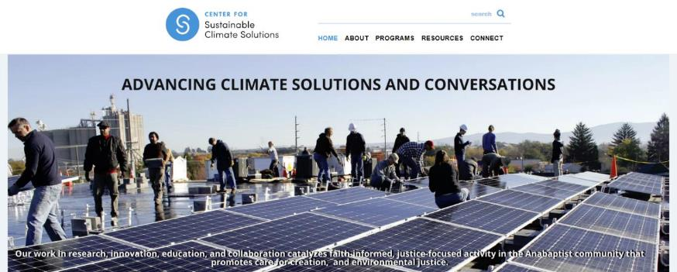

sustainableclimatesolutions.org
Notes:
Half of my job is director of this organization, CSCS. This is a joint effort of three Mennonite institutions – EMU, Goshen and MCC. We are based out of EMU, but full partners with these other 2 institutions, which makes us a bit of a unique institution.
Our mission statement is the following…
We’ve talked about some solutions, but what I want to point out from our frontpage here is the conversations part, which is really actually a solution.

Slide 6
sustainableclimatesolutions.org
Notes:
Half of my job is director of this organization, CSCS. This is a joint effort of three Mennonite institutions – EMU, Goshen and MCC. We are based out of EMU, but full partners with these other 2 institutions, which makes us a bit of a unique institution.
Our mission statement is the following…
We’ve talked about some solutions, but what I want to point out from our frontpage here is the conversations part, which is really actually a solution.

Slide 7
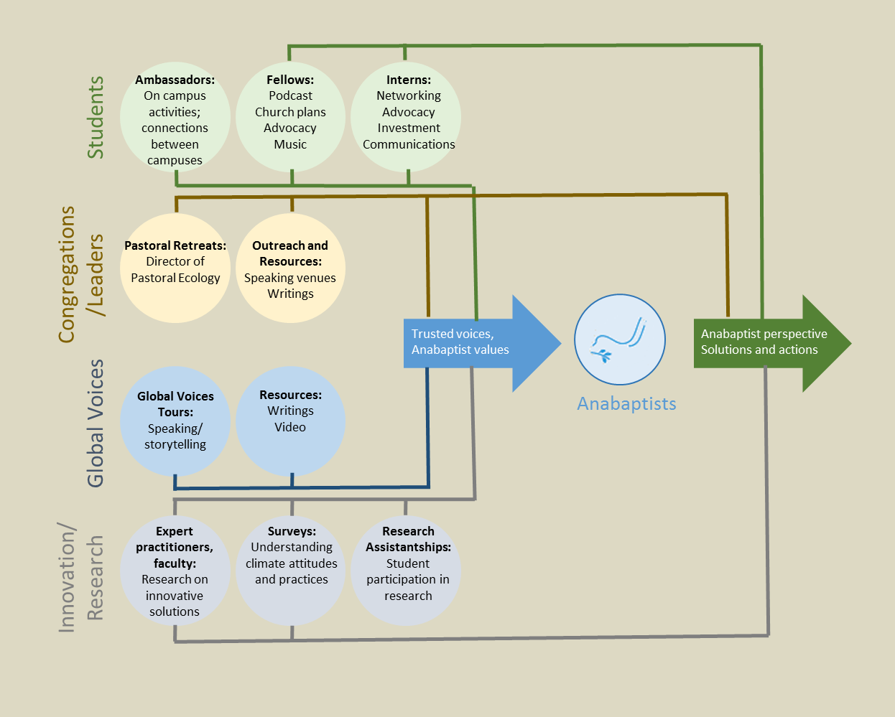
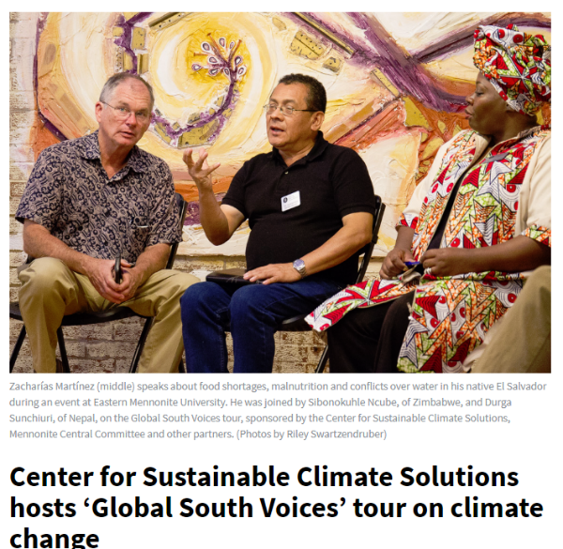

Slide 8
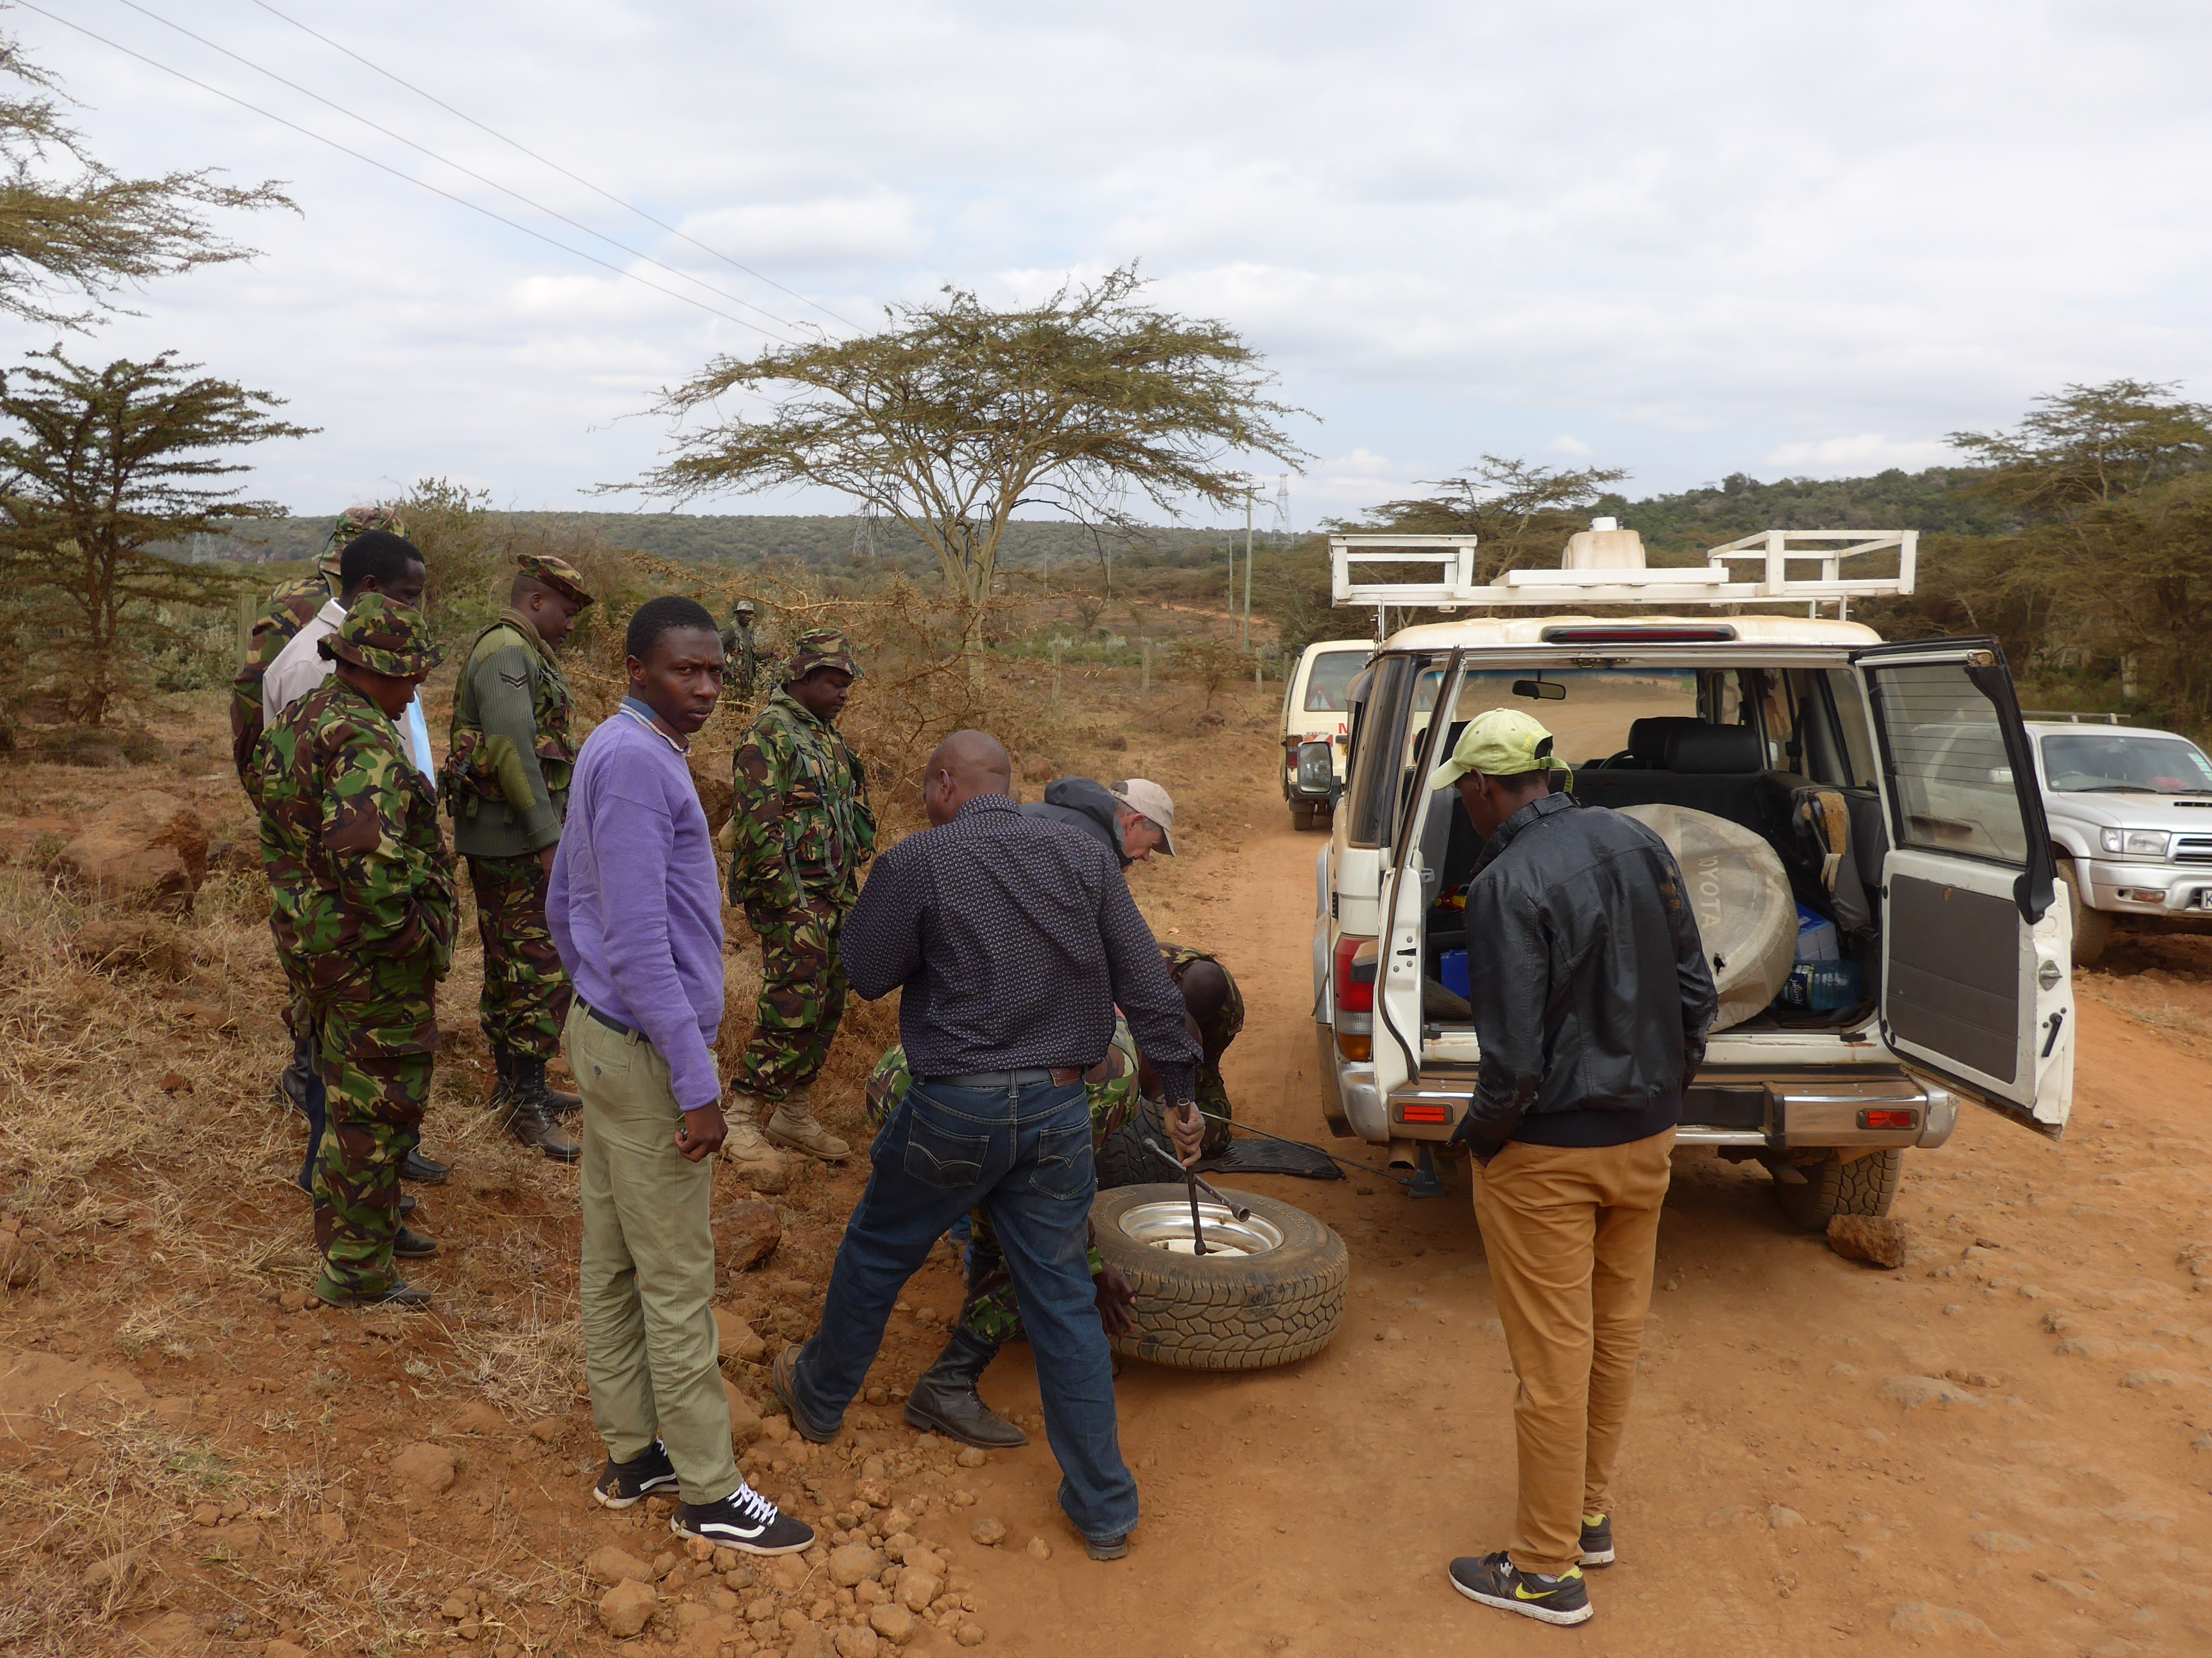
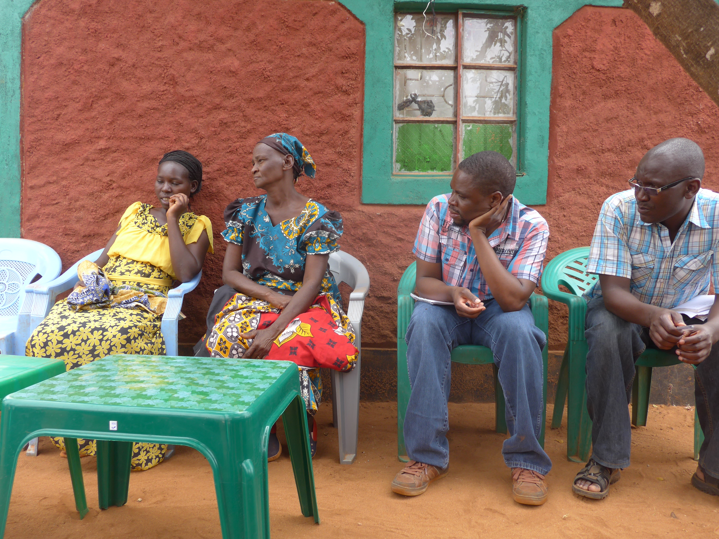
Right and Wrong in a Warming World

Slide 9
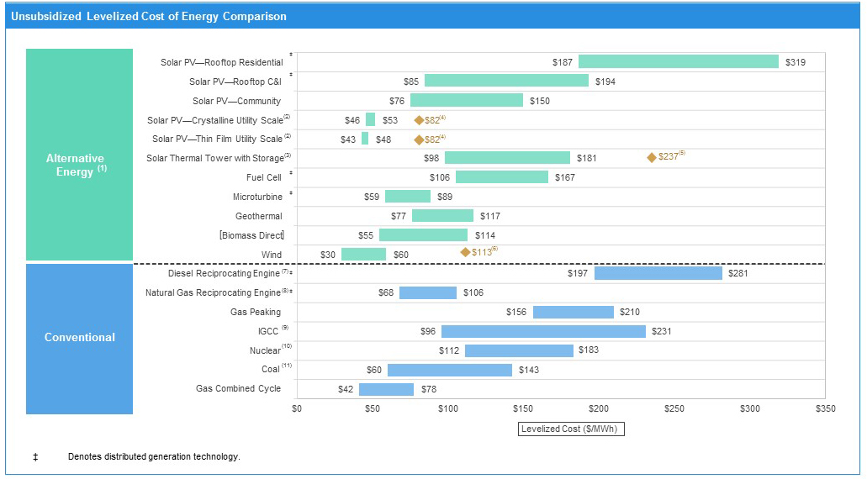
It wasn’t about this…

Slide 10
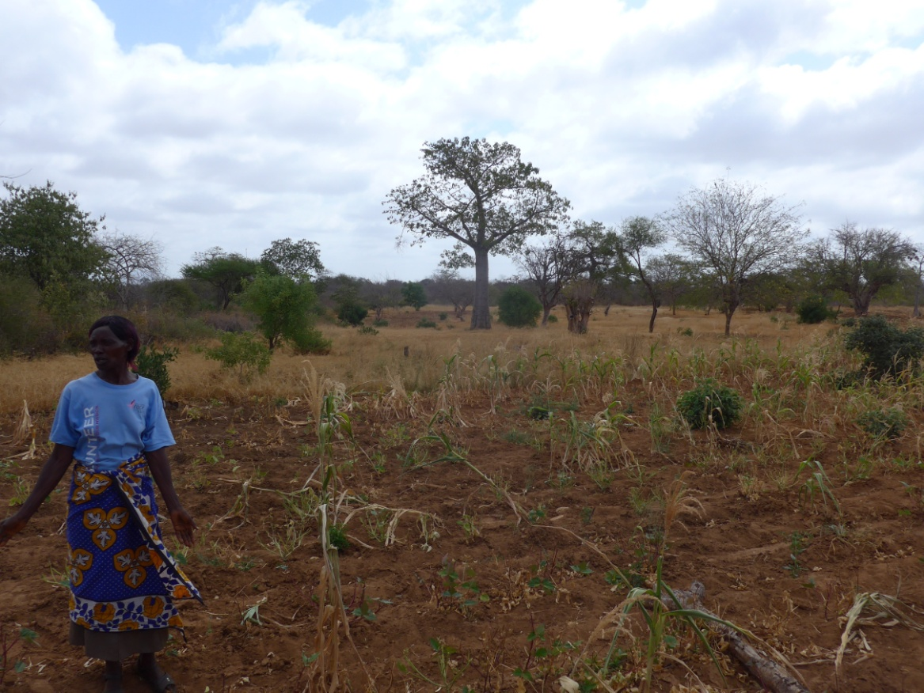
It was about the reality of daily life…

Slide 11
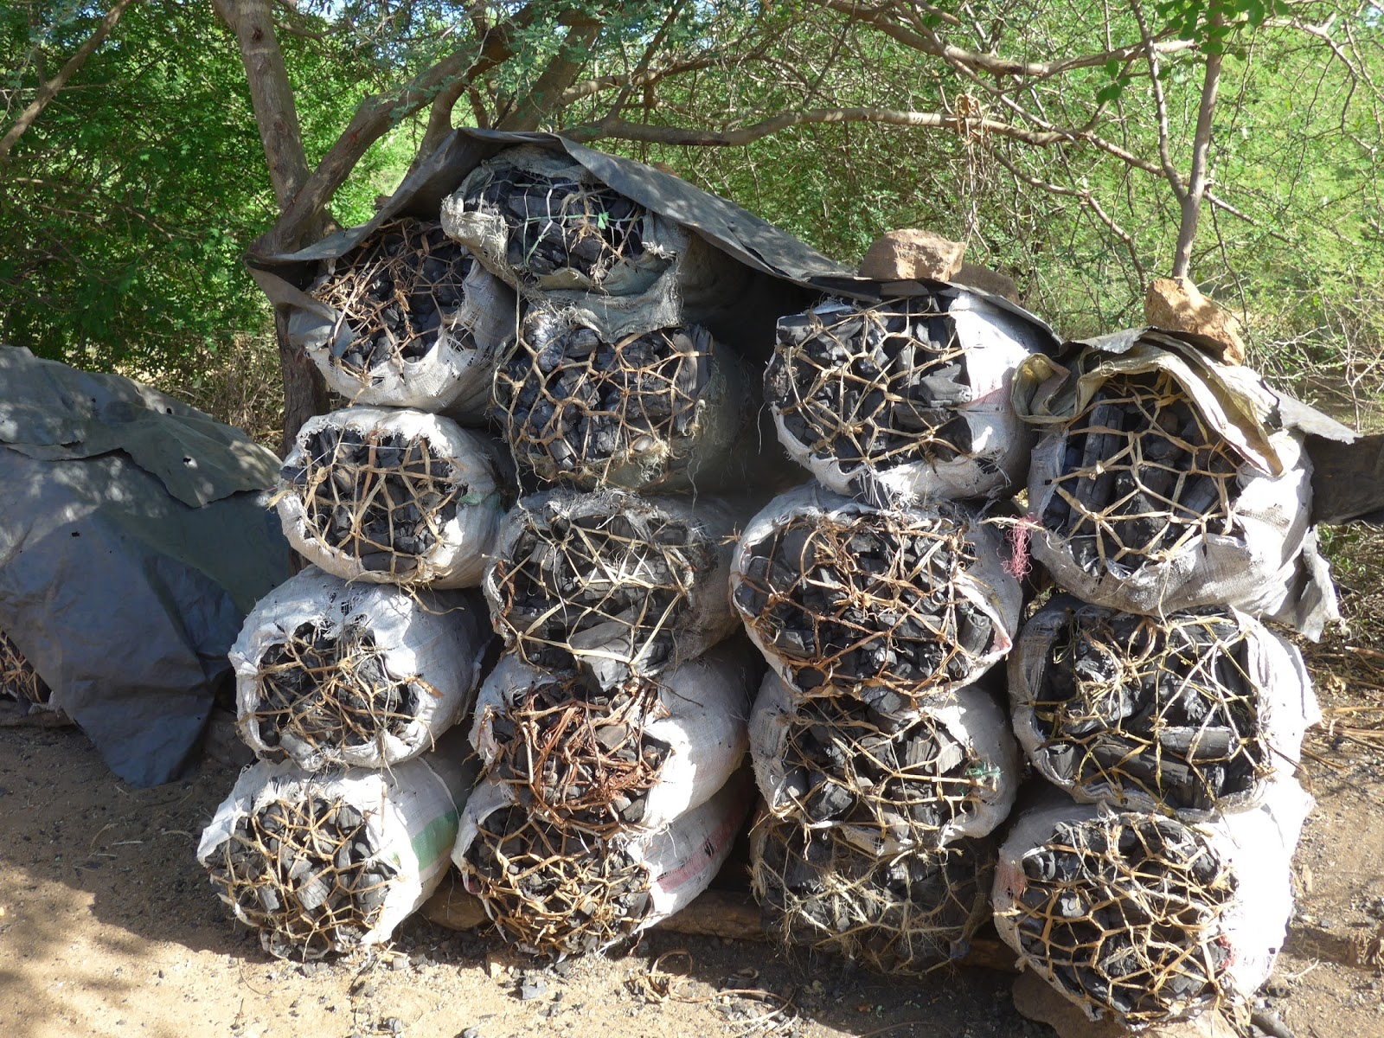

Slide 12
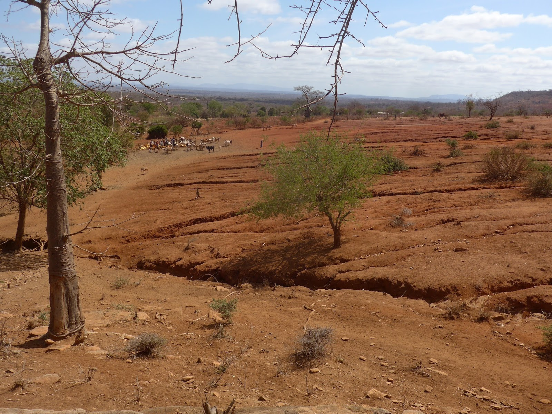

Slide 13
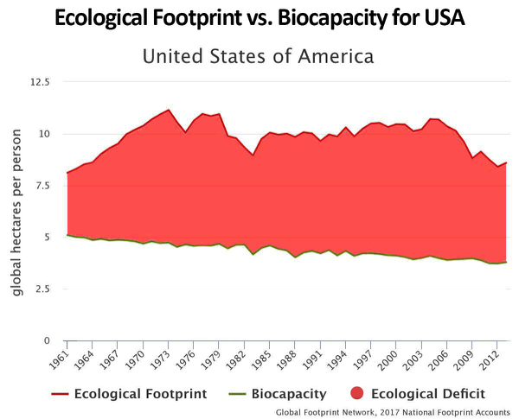
The injustice…

Slide 14
1. What are some components of moral or theological arguments about climate change?
2. What’s the importance of a moral or theological argument? (If there is such an argument, does it make a difference?)

Slide 15
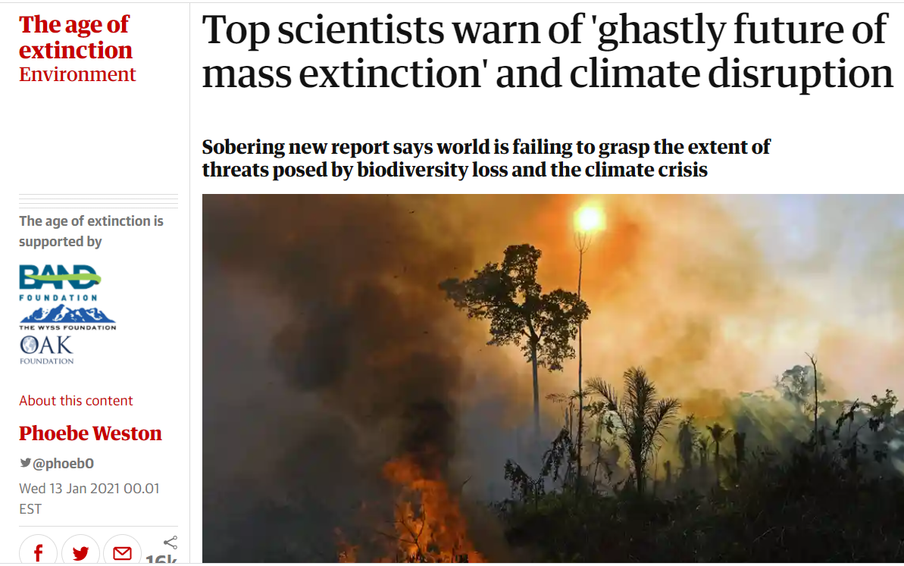
But first…clear the air about climate change
It is happening
It is us
It is bad

Slide 17
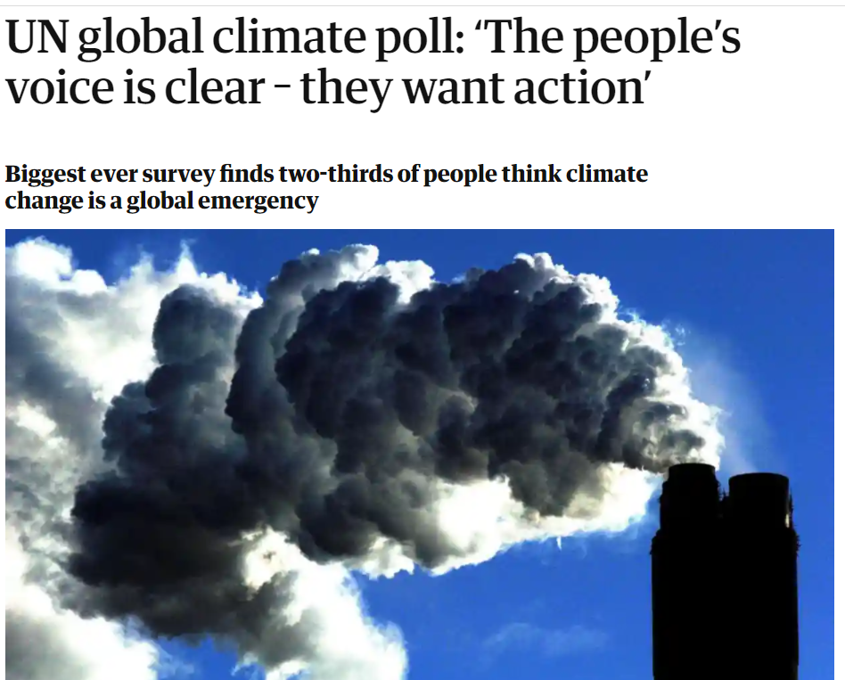
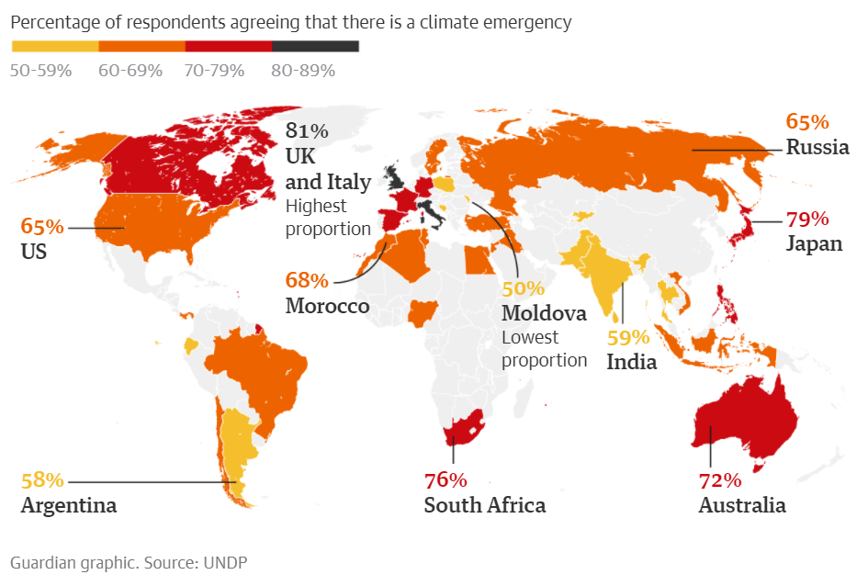
But first…clear the air about climate change
It is happening
It is us
It is bad
We care about it

Slide 18
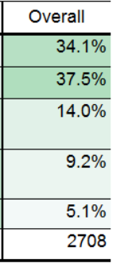
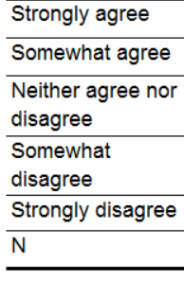
2017 : A survey of of MCUSA constituents
72%

Slide 19
knowledge, attitudes, practice (behavior)
“The impact of the climate change hysteria propagated by mainstream media, the UN, and the so called 97% of scientists who believe in human-caused climate change, and the purported belief that if we take drastic measures (which will take trillions of dollars and result in the economic destruction of many regions of the world), we might have the ability to change things and save our planet is the most astounding, discouraging, and frustrating part of this whole scheme. We will NEVER be able to do enough for those people.”
– Respondent, Canada
Credit: CSCS, data from students at 7 liberal arts colleges (Mennonite)

Slide 20
It is happening
It is us
It is bad
We care about it
And we can do something about it

Slide 21
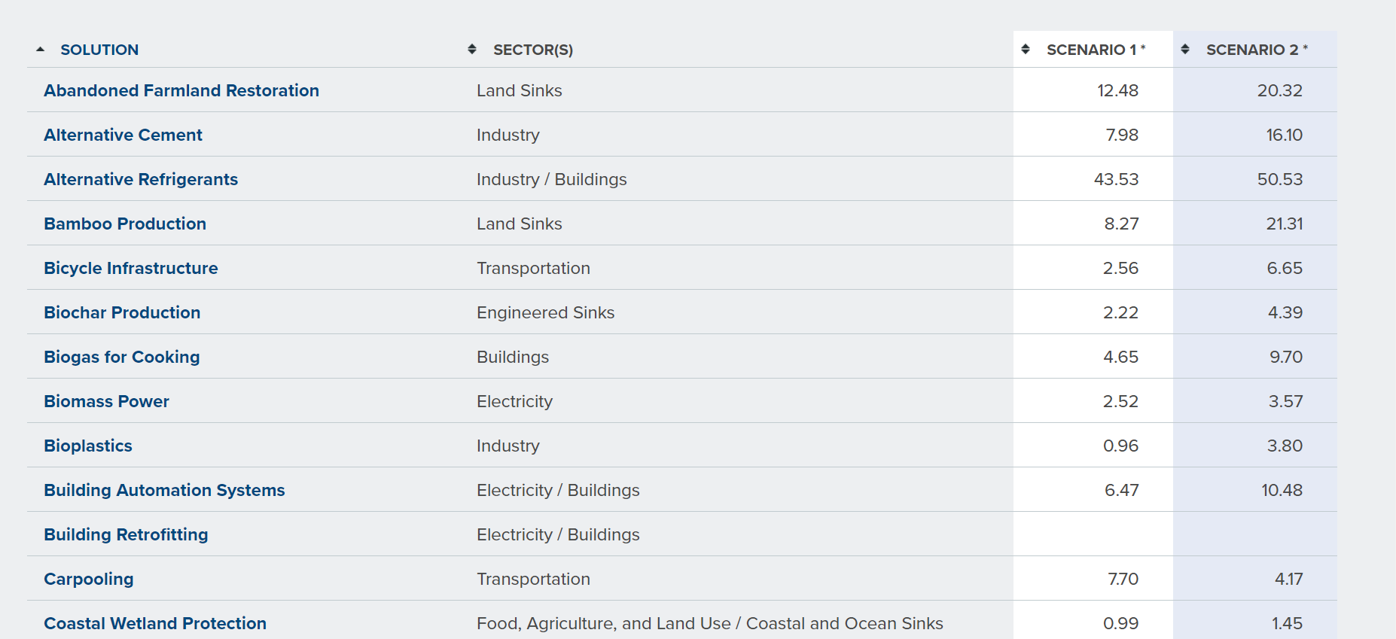
https://drawdown.org/solutions/table-of-solutions

Slide 22
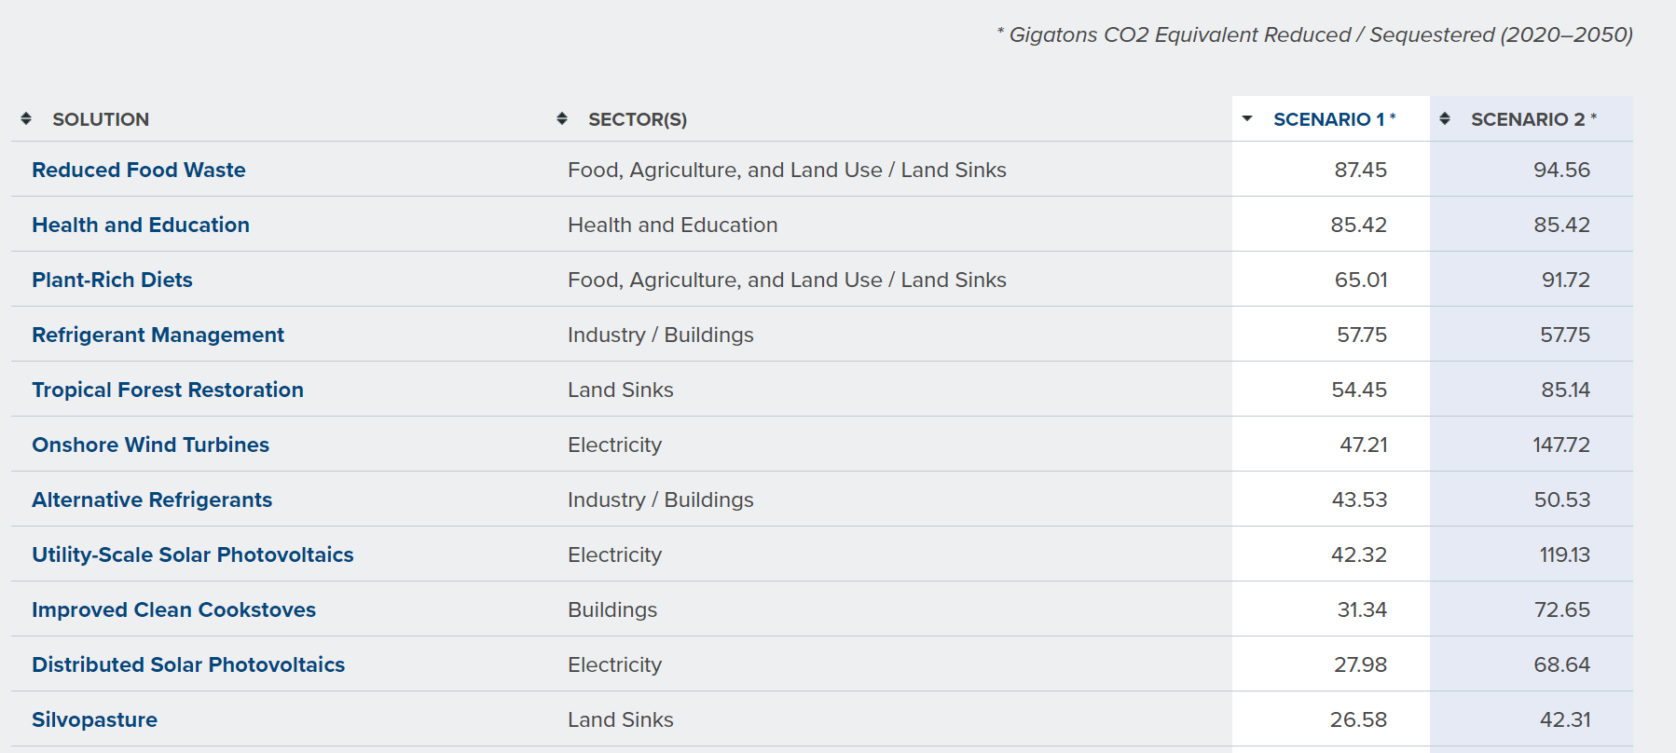
https://drawdown.org/solutions/table-of-solutions

Slide 23
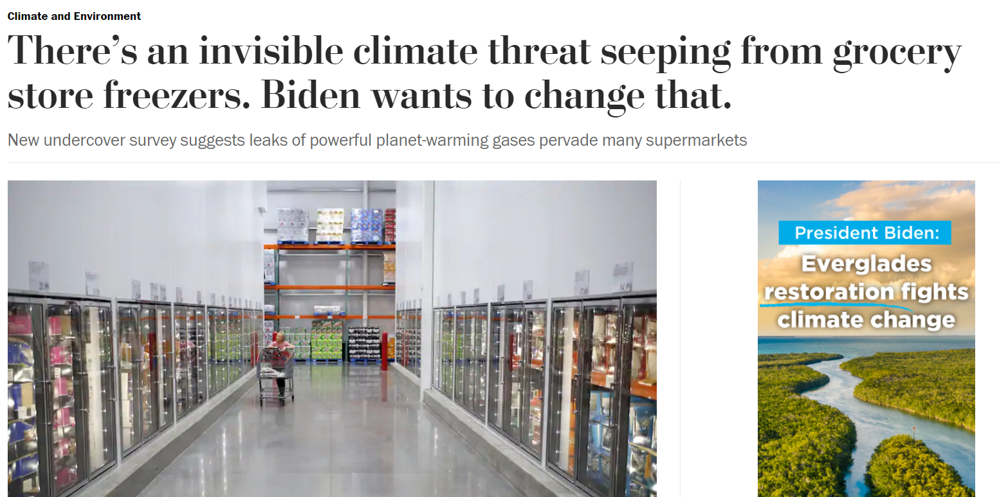
The Biden administration now sees eliminating these chemicals from the nation’s refrigerators as low-hanging fruit in its broader effort to rein in climate pollutants. The Environmental Protection Agency issued a public call last week for companies to report production and import data on HFCs.

Slide 24
It is happening
It is us
It is bad
We care about it
And we can do something about it
But we don’t (do much)

Slide 25
knowledge, attitudes, practice (behavior)
Credit: CSCS, data from students at 7 liberal arts colleges (Mennonite)

Slide 26
It is happening
It is us
It is bad
We care about it
And we can do something about it
But we don’t (do much)..why not?

Slide 27
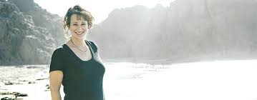


The myth of apathy
Renee Lertzman
“Renee Lertzman…pointing out that there is a ‘myth of apathy’. Many people in fact care too much, not too little, and as a result they resort to psychological and social defenses. Albrecht calls this state ecoparalysis; people would like to be able to act, but find themselves paralyzed. This naturally has dire consequences for sustainability.
…The numbing of emotional life is connected to what Lertzman calls ‘environmental melancholy.’ People resort to a kind of anticipatory mourning where they try to break down in advance the emotional connections to certain things so that they don’t have to suffer when they lose them.”
– Panu Pihkala

Slide 28
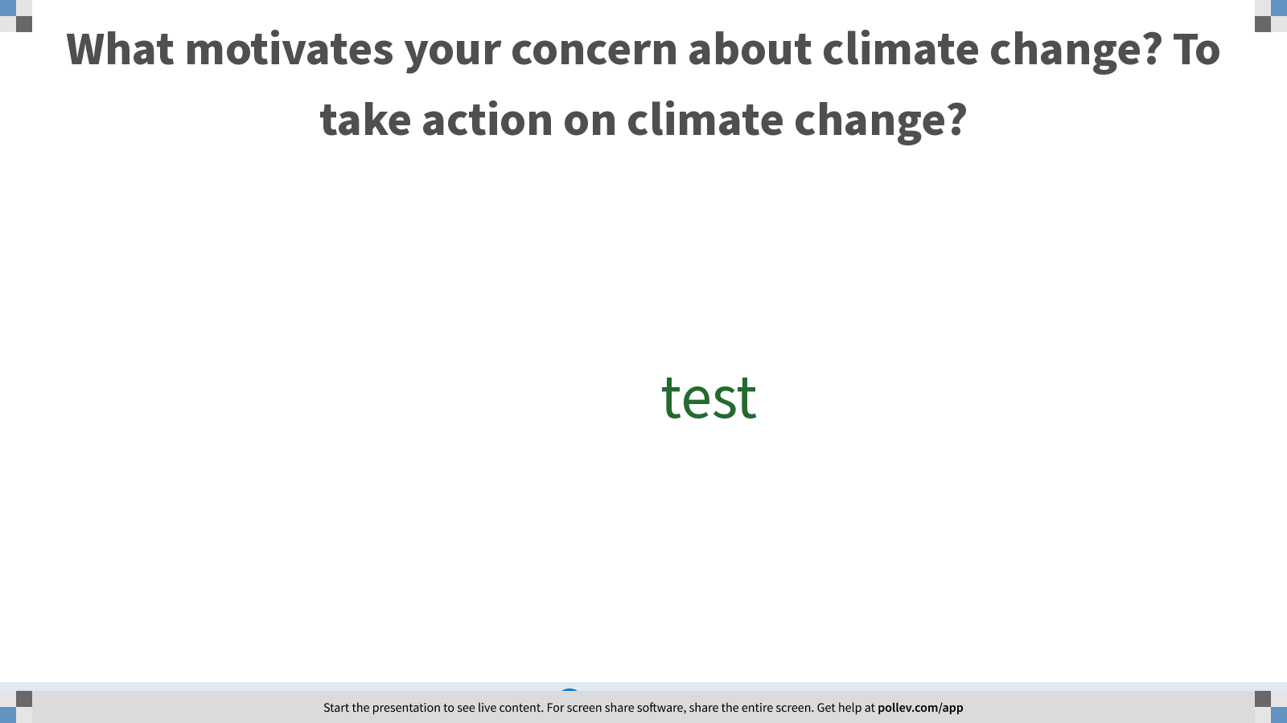
Notes:
Poll Title: What motivates your concern about climate change? To take action on climate change?
https://www.polleverywhere.com/free_text_polls/UuOQCktvqTOc8x4c0pP0v

Slide 29
The food fight in environmentalism (well, one of them) – what’s the best motivator?
So we agonize about how to best get people to act. How do we convince ourselves?

Slide 30
Framing climate change based on what is right or wrong is one possible way of motivating people to change.
It’s a deficit in information
There’s not a good economic motivation
We’re not taking our moral mandate seriously
So we agonize about how to best get people to act. How do we convince ourselves?

Slide 31
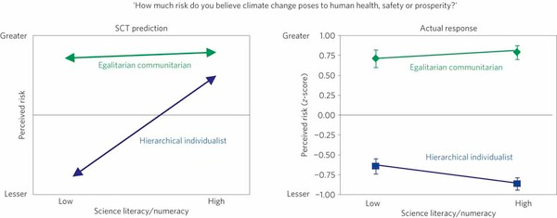
Information Deficit Model. What happens if we are better informed?

Slide 32
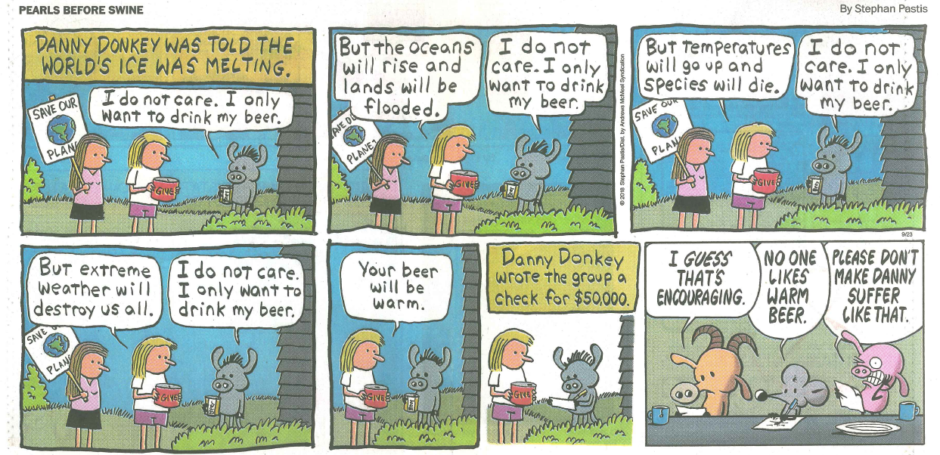
Economics. Can goals be reached through enlightened self interest? Are we rationale actors?

Slide 33
Or a moral frame?

Slide 34
Psalm 24:1: "The Earth is the Lord's and all that is in it, the world, and those who live in it"

Slide 35
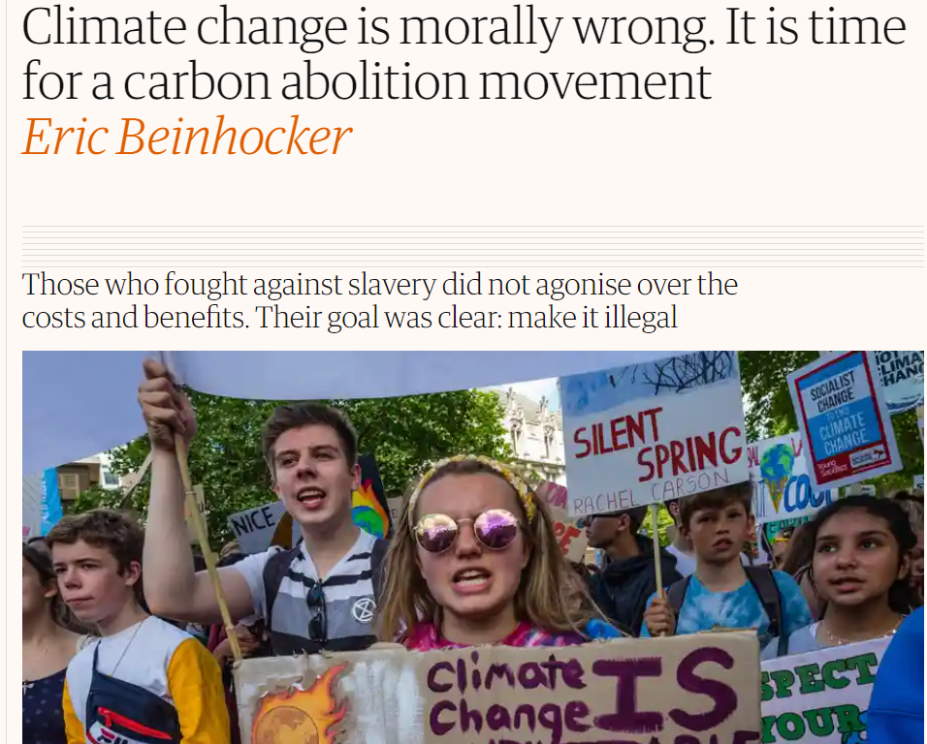

Slide 36
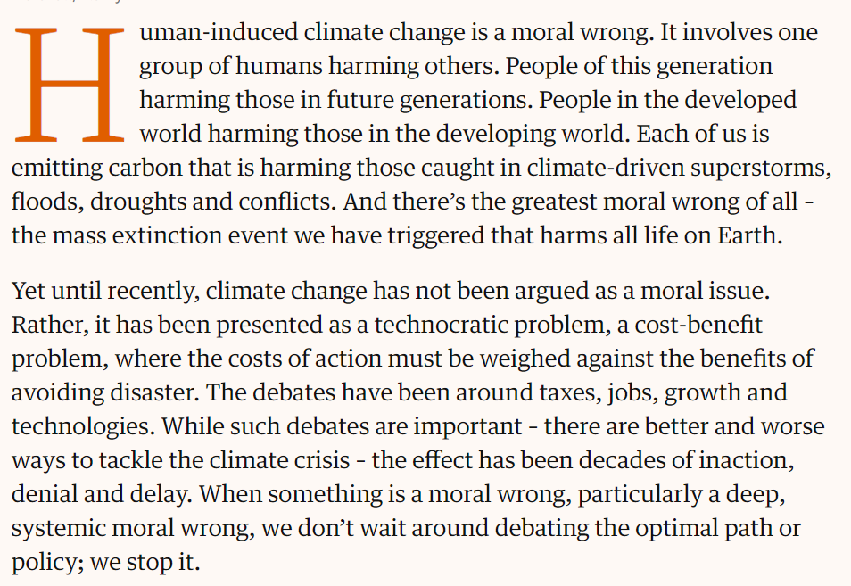

Slide 38

What are components of the moral argument?
Right and Wrong means…thinking about the other

Slide 39
Chair #1 : The global human community argument
“..not until Hiroshima did human agency being to awaken to its newfound faculty for worldwide catastrophe. Not until the last few decades has the exponential expansion of our fossil fuel exploitation given us a lever with which to move the world.
…It requires us to consider our neighbours who may be harmed by our actions more than we’ve ever had to before”
S. Gardiner in The Perfect Moral Storm
The King will reply, 'Truly I tell you, whatever you did for one of the least of these brothers and sisters of mine, you did for me.’ – Matt 25:40

Slide 40
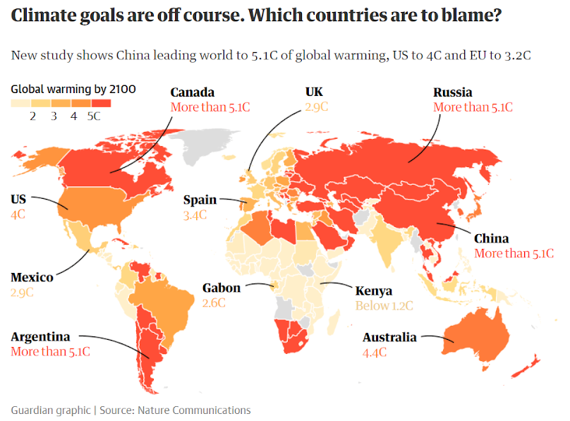

Slide 41
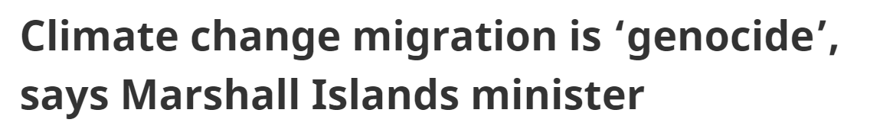
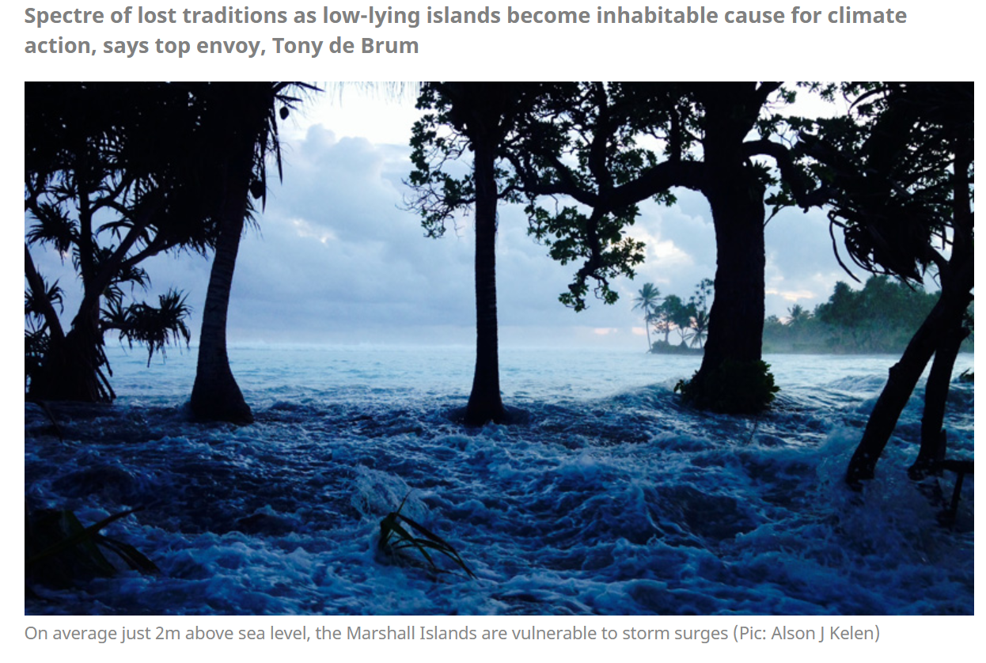

Slide 42
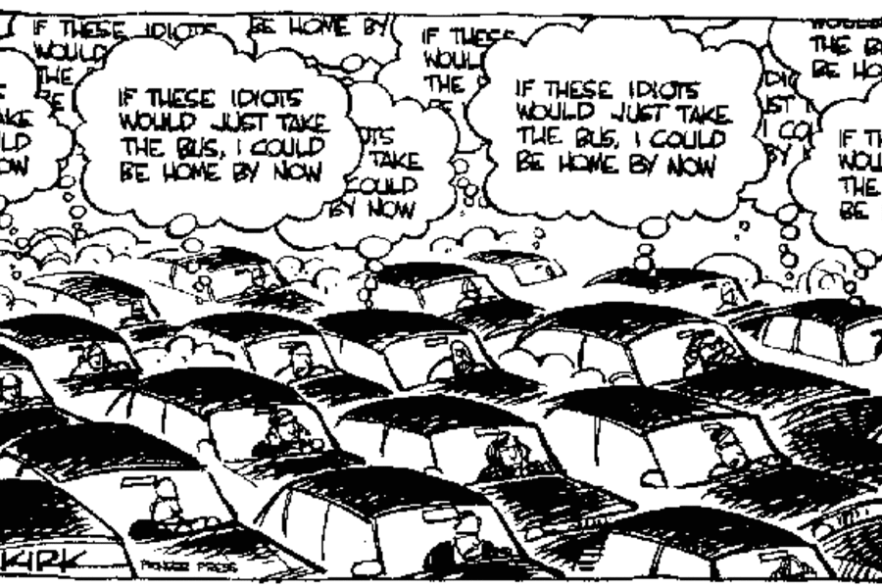
Climate change as a tragedy of the commons

Slide 43
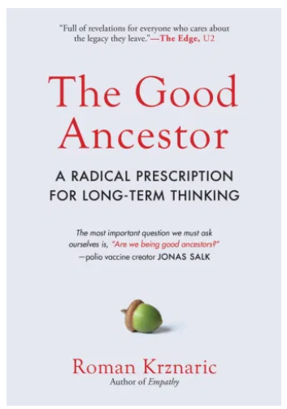

Chair #2 : The generational argument
“…duty of care and custodianship towards resources and the environment that current generations owe future generations
(intergenerational justice)”

Slide 44
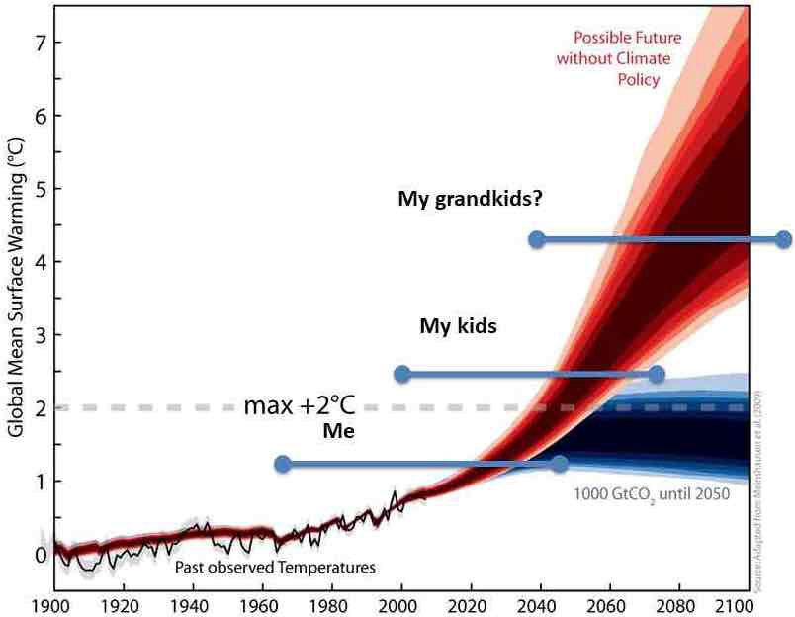
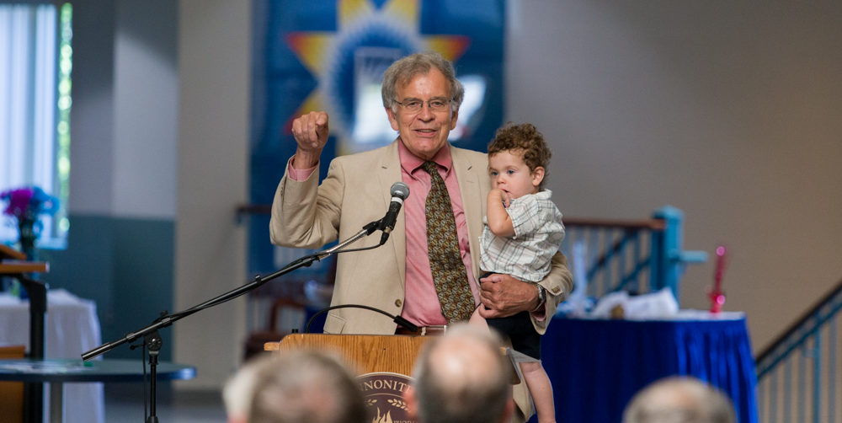
Why are you here? What is the world that will be left for your grandchildren?

Slide 45
Global and Generational ethics, is this different than other moral challenges we’ve faced?
“..not until Hiroshima did human agency being to awaken to its newfound faculty for worldwide catastrophe. Not until the last few decades has the exponential expansion of our fossil fuel exploitation given us a lever with which to move the world.
…It requires us to consider our neighbours who may be harmed by our actions more than we’ve ever had to before”
S. Gardiner in The Perfect Moral Storm

Slide 46
Chair #3 : The nature’s standing argument
"A thing is right when it tends to preserve the integrity, stability, and beauty of the biotic community. It is wrong when it tends otherwise.“
"The land ethic simply enlarges the boundaries of the community to include soils, waters, plants, and animals, or collectively: the land...[A] land ethic changes the role of Homo sapiens from conqueror of the land-community to plain member and citizen of it. It implies respect for his fellow-members, and also respect for the community as such."
-Leopold, Land Ethic

Slide 47
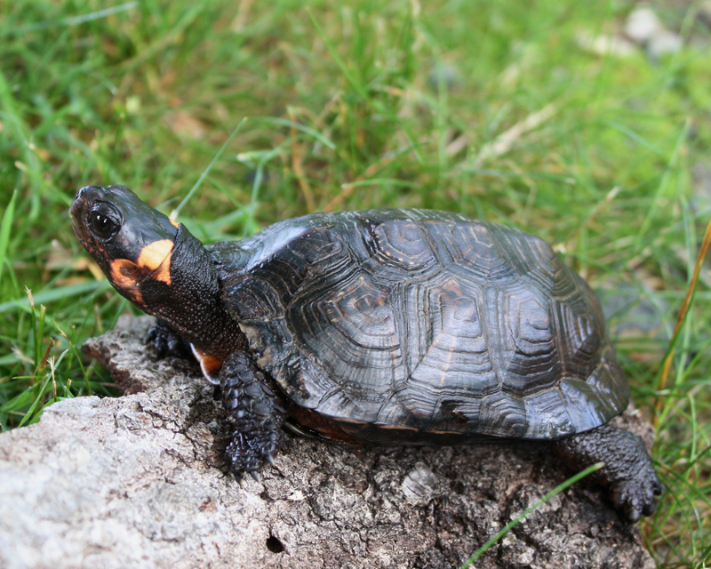
“The Endangered Species Act doesn’t claim that our existence depends on the existence of wild species. It says that we, the people, don’t let species go extinct, that this is who we are. It’s not about practicality; it’s about morality.” – Carl Safina

Slide 48
In every case, central to the moral argument is ‘the other’
The greatest spiritual revolutionary in Western history, Saint Francis, proposed what he thought was an alternative Christian view of nature and man's relation to it; he tried to substitute the idea of the equality of all creatures, including man, for the idea of man's limitless rule of creation. He failed. Both our present science and our present technology are so tinctured with orthodox Christian arrogance toward nature that no solution for our ecologic crisis can be expected from them alone. Since the roots of our trouble are so largely religious, the remedy must also be essentially religious, whether we call it that or not. We must rethink and refeel our nature and destiny. The profoundly religious, but heretical, sense of the primitive Franciscans for the spiritual autonomy of all parts of nature may point a direction. I propose Francis as a patron saint for ecologists. – Lynn White

Slide 49
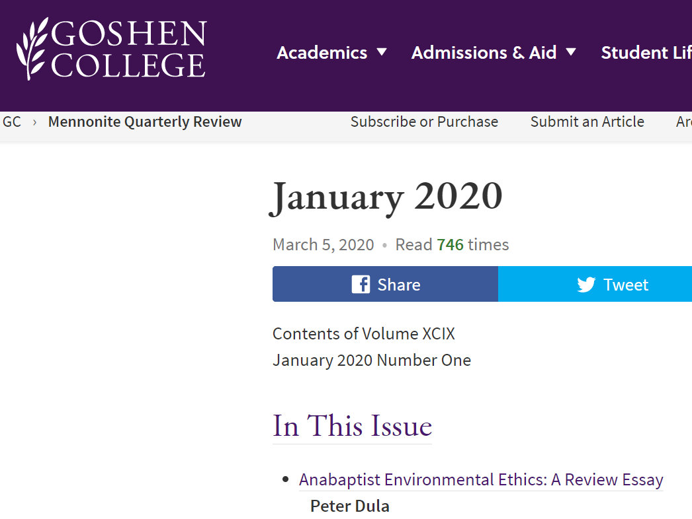
What are some components of the theological / Christian ethic argument?

Slide 50
Anabaptist Approaches to Creation Care
Peter Dula
Model, Christian Environmental ethics | Analogous secular Environmental ethics | Emphasis on..
Stewardship | Moral Agency | God
Eco-justice | Nature’s Standing | Nature
Eco-spirituality | Ecological Subjectivity | Humanity
"One might think of the three strategies as each focused on one aspect of the triad of nature, God, humanity. Ecojustice leans towards describing the ecological crisis as injustice towards nature. Stewardship tends to frame it as disobedience to God. Eco-spirituality refuses to let us forget how humanity is equally disfigured in the process."

Slide 51
MCUSA Confession of Faith
Article 6. Creation and Calling of Human Beings
We believe that God has created human beings in the divine image. God formed them from the dust of the earth and gave them a special dignity among all the works of creation. Human beings have been made for relationship with God, to live in peace with each other, and to take care of the rest of creation.
We believe that human beings were created good, in the image of God.1 As creatures according to the divine likeness, we have been made stewards to subdue and to care for creation out of reverence and honor for the Creator.2 As creatures made in the divine image, we have been blessed with the abilities to respond faithfully to God, to live in harmony with other human beings, and to engage in meaningful work and rest. Because both Adam and Eve were equally and wonderfully made in the divine image, God’s will from the beginning has been for women and men to live in loving and mutually helpful relationships with each other.3
We are grateful that God patiently preserves humanity and faithfully remains with us even through death.4 God has made provision for the salvation of humanity and the redemption of creation.5 We believe that the image of God in all its fullness has been revealed and restored in Jesus Christ, in whom we find our true humanity.6

Slide 52
Anabaptist Approaches to Creation Care
Peter Dula
Model, Christian Environmental ethics | Analogous secular Environmental ethics | Emphasis on..
Stewardship | Moral Agency | God
Eco-justice | Nature’s Standing | Nature
Eco-spirituality | Ecological Subjectivity | Humanity
"One might think of the three strategies as each focused on one aspect of the triad of nature, God, humanity. Ecojustice leans towards describing the ecological crisis as injustice towards nature. Stewardship tends to frame it as disobedience to God. Eco-spirituality refuses to let us forget how humanity is equally disfigured in the process."

Slide 53
Anabaptist Approaches to Creation Care
Peter Dula
Model, Christian Environmental ethics | Analogous secular Environmental ethics | Emphasis on..
Stewardship | Moral Agency | God
Eco-justice | Nature’s Standing | Nature
Eco-spirituality | Ecological Subjectivity | Humanity
"Nature’s standing emphasizes the obligations humans have to the nonhuman world because of its intrinsic value. In contrast the kinds of utilitarianism that view non-human nature solely as object for human use, nature has moral standing.
Theologically speaking, non-human creation has this standing because all of creation exists in independent relationship to God just as much as humans. Human violation of the rest of creation is sinful because it is a violation of that God/creation relationship." - Dula

Slide 54
From Community Mennonite Church, “green congregation” proposal
Creation is our neighbor. How do we treat our neighbor? Have we been a good neighbor through our lifestyle practices? Our goal in being a Green Congregation is to become better neighbors at the individual, church, community and global levels. We will find ways to make the church building and grounds an example of how to reduce energy, manage water, grow food and support our human and ecological neighbors. We will reduce our individual and collective carbon footprint(s) and aid those who wish to act but do not have the resources. We will together let the ecology of this place we call home become healthier and more whole for the good of all of our neighbors.

Slide 55
Model, Christian Environmental ethics | Analogous secular Environmental ethics | Emphasis on..
Stewardship | Moral Agency | God
Eco-justice | Nature’s Standing | Nature
Eco-spirituality | Ecological Subjectivity | Humanity
"One might think of the three strategies as each focused on one aspect of the triad of nature, God, humanity. Ecojustice leans towards describing the ecological crisis as injustice towards nature. Stewardship tends to frame it as disobedience to God. Eco-spirituality refuses to let us forget how humanity is equally disfigured in the process."

Slide 56
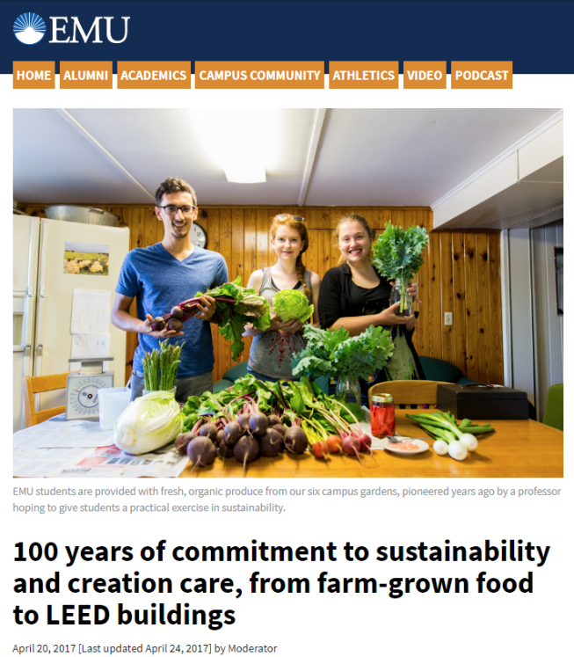
"A younger generation of Anabaptists, however, seems to agree that that extension of love looks like the organic farm. In this, young Anabaptists participate in a significant shift in the N. American environmental movement. Where a generation ago, the great symbols and inspirations of environmentalism were John Muir, Henry David Thoreau and the wilderness, now it is Wendell Berry and the farm. The old wilderness ideal celebrated and fought for the preservation of places untouched by humans, thereby reinforcing the human/non-human nature gap. The garden, or small organic farm, celebrates places where humans are in mutually constituting relationships with ecosystems." - Dula

Slide 57
Percent of Mennonites across Four Christian Environmental Views (n=7294)
“God has control, don’t worry”
“We have a mandate to tend God's garden”
“The earth has value even without us”
“We should act like we’re part of creation”

Slide 58
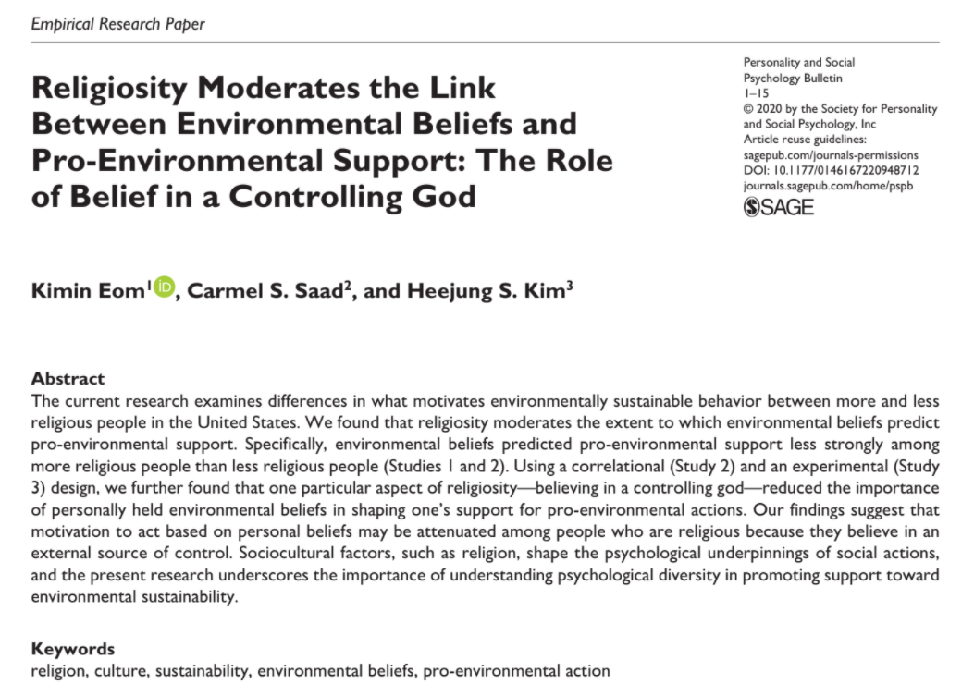
Some challenges to the moral and theological response
There are theological strands which push against “pro-environmental” actions
…religions commonly instruct their believers to surrender one’s will and control to follow a god or deity’s plan. For example, the apostle Paul states in the Bible that after becoming a believer, “I no longer live, but Christ lives in me” (Galatians 2:20). Muhammad also teaches in the Qur’an, “Nothing will happen to us besides what God has decreed for us. He is our Guardian” (Qur’an 9:51).

Slide 59
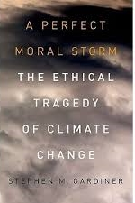
There are aspects to climate change that are particularly threatening to a moral response
Is this the “The perfect moral storm?”
Global threat
Temptations of intergenerational buck passing
Lack of theoretical framework

Slide 61
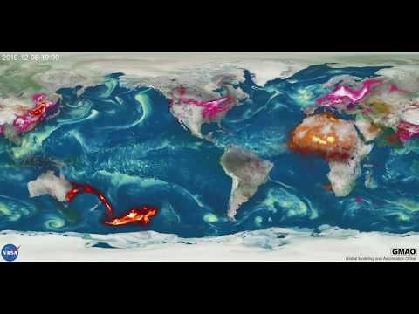

Slide 62
So we are all complicit, we can’t escape that
“..The individual decisions and patterns of behaviour are very frequently innocuous enough, even praiseworthy, considered on their own. It is only cumulatively that they represent a grave threat. ..This means that no single individual or even nation bears total responsibility and none can single-handedly prevent disaster. The fact that the atmosphere is common to all means co-operation is crucial if we wish to reduce the dangers. We are all guilty, but each powerless on our own.”
Gardiner, The Perfect Moral Storm

Slide 63
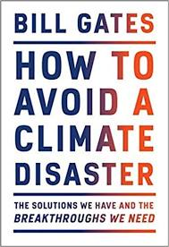
And it’s overwhelming
“There are two numbers you need to know about climate change. The first is 51bn. The other is zero.
Fifty-one billion is how many tons of greenhouse gases the world typically adds to the atmosphere every year. Zero is what we need to aim for. To stop the warming and avoid the worst effects of climate change, humans need to stop adding greenhouse gases to the atmosphere.”

Slide 64
This leads to moral corruption
Literal denial
Interpretive denial
Implicatory denial
“a failure to integrate…knowledge [of climate change] into everyday life or transform it into social action.”
So inaction comes not from ignorance, ideology, apathy, greed (e.g. rational actor), but is more complicated. It comes through a process of community interaction where there is social sanctioned silence.
“People want to protect themselves a little bit.” – Norwegian villager

Slide 65
None-the-less, there is a moral and theological argument
So we agonize about how to best get people to act. How do we convince ourselves?

Slide 66
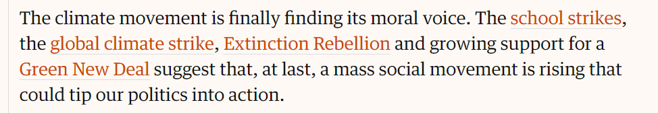
Is this what motivates people?
Actually, we don’t exactly know! I suspect so…under the right circumstances

Slide 67
“We find mixed evidence regarding frame effectiveness.”

Slide 68
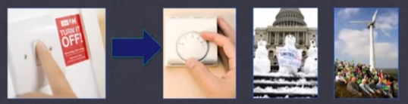

“‘spillover’ is only likely to happen when people internalise the reasons for their low-carbon decision-making.” - CASPI project

Slide 69

What is your legacy? Maybe this motivates us to action?
“I think its quite conceivable that in terms of our legacy — how were thought of by future people — this might well be the defining issue of our generation. Our complacency about it will be seen in a similar way to the complacency of past generations about deep social problems such as slavery.”
Gardiner

Slide 70

Is this what motivates people?
Maybe our goal should be live a faithful or virtuous life, not to be, above all things, effective

Slide 71




Slide 72

Are we a people of conscious?

Slide 73

Leaving you with voices : Korenna Gore

Slide 74


Leaving you with voices : Pope Francis

Slide 75
Leaving you voices : Pope Francis
“The earth, our home, is beginning to look more and more like an immense pile of filth”
Pope Francis

Slide 76
Thanks & Credit to:
Other CSCS staff – Doug Kaufman, Daniel Bellerose, Sibonokuhle Ncube; and the many students involved
Colleagues at Eastern Mennonite University, Mennonite Central Committee, Goshen College (Dula, Holsinger, and many others)
Experts in climate communication (Gardiner, Hayhoe, Leiserowitz, Maibach, etc) whose ideas I’ve reflected in this presentation

Slide 77
“I think its quite conceivable that in terms of our legacy — how were thought of by future people — this might well be the defining issue of our generation. Our complacency about it will be seen in a similar way to the complacency of past generations about deep social problems such as slavery.”
Gardiner
“For unto whomsoever much is given, of him shall be much required” (Luke 12:48)
Photo: Science, v326 18 Dec 2009 p1646

Slide 78
Anabaptist Approaches to Creation Care
Peter Dula
A Future for Anabaptist Environmental Ethics
So is there particular Anabaptist or Mennonite approach to issues of environmental ethics? Some essence or common ground that links the variety I have tried to outline? The time is long past, or ought to be, when Anabaptist theologians had the temerity to narrow the tributaries of Anabaptism into one stream. Anabaptism is, and always has been a complex, diverse and contested movement. There is no reason to think that its reflection on the environmental crises of our time would be any different. The most I am willing to claim is that each of these widely shared approaches draw on particular aspect of the long argument that is Anabaptism. Stewardship is influenced by Anabaptist theological concerns about conventional theologies of creation. Eco-justice and eco-spirituality are turned in nonviolent directions. Agrarianism inherits and modifies Anabaptism’s rural heritage. Watershed Discipleship builds on Anabaptist ecclesiological affection for local and anti-statist forms of politics.
Jenkins thought that the Anabaptists were most at home in the stewardship model. I have argued that much of contemporary Anabaptist theology in fact draws more upon the model of eco-spirituality, though in different ways. In conclusion, I want to say a bit about why that shift may have happened.

